Slide 1
CISC108
Introduction to Computer Science
[TA Name]
[TA Name]
University of Delaware
Week 7 - Sequences Designer

Slide 2
[TA Name]
[TA Name]
[TA Photo]
[TA Photo]

Slide 3
This week’s lab:
Designer Worlds!

Slide 4
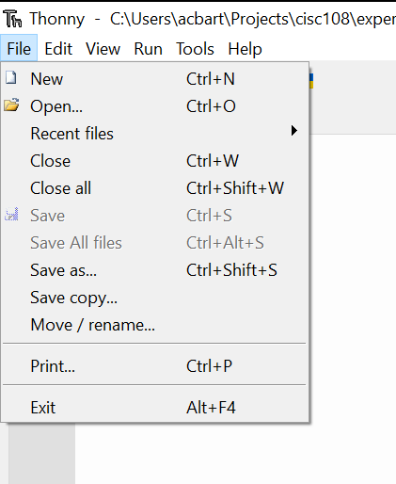
Need to make a new empty file in Thonny:
teleporting_box.py
Make sure you save the file somewhere you can find it, in a folder!
Keep things organized!

Slide 5
Today’s Lab Assignment
Follow the usual instructions for breaking into groups and then making a copy of the worksheet.
Part 1 (Individual):
Complete the Designer Worlds tutorial (~20 minutes)
Part 2 (Group):
Work together to answer the critical thinking questions
Notes:
The next slide has instructions for installing Designer, in case anyone needs them.

Slide 6
Installing Designer
Designer should have been installed when you installed Thonny
But if it wasn’t...
In the top menu bar, click "Tools" => "Manage Packages" so that the Manage Packages window appears.
In the search box at the top of the window, type designer
Click "Find package from PyPI" to the right of the search box
Click the "Install" button - a new window will appear.
Installation make take a little while depending on your machine.

Slide 7
CISC108
Have a great day!
Don’t forget:
Need to finish module 7 this week!
Need to read Primer 8 before next lab!
See ya!

